Slide 1

The Ice Cubes team:
“Sans Sharma”, “Nicole Briggs”, “Beth Scott”, “Rain Yang”
GLOBAL TEMPERATURE CHANGE

Slide 2


Climate Change
Hypothesis : The worldwide population growth has a direct correlation to changes in temperature, assuming that the global temperature has actually increased.
How has global average temperature changed in the last century?
Is there a correlation between global average temperature and population?
Is there a difference in average temperature change between the Northern and Southern hemispheres?
Which countries experienced the largest fluctuations in average temperature and does this correlate with larger populations?
How does USA temperature rises compare with Australia’s temperature rises?

Slide 3


What motivated us to answer them...
We were curious to understand from the data if there were any correlations with population growth. We believe the global population has increased in the last century, has this had a direct affect on temperature. If the answer is yes, we could make comparisons with local geographies.
We agreed to compare the Northern vs. Southern hemispheres as 90% of the human population live in the Northern hemisphere.
Countries that experienced the most significant fluctuations in temperatures was extracted to see whether this was directly related to countries with the highest growth in population.
And lastly, we wanted to make a comparison between two specific countries. We selected USA and Australia as they represent both hemispheres, and one has a significantly higher population than the other (335 million vs. 25 million).
As a group we were satisfied with our findings which we will now summarise for you !

Slide 4
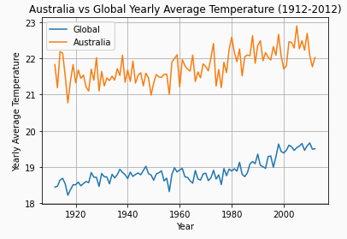
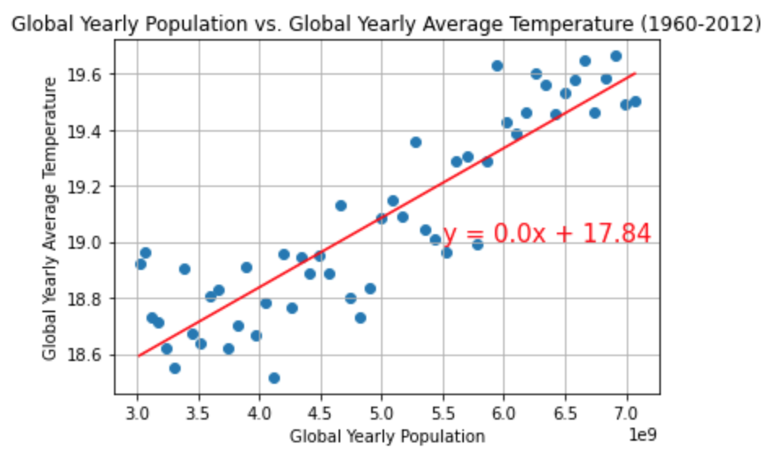
Global average temperature
Both graphs confirm that over time as global population is rising there has been an increase of average temperature.
For global average temperature, two graphs were made. One that shows average global temperature over time, and another that shows average global temperature vs. population:
The r-squared is: 0.7944268605457065

Slide 5
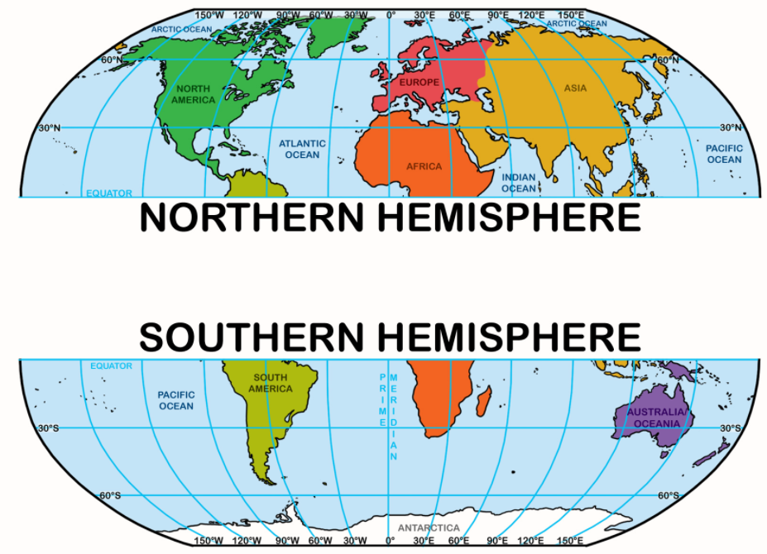
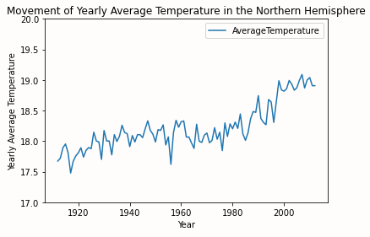
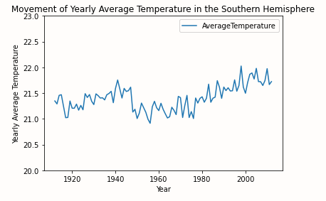
Northern Hemisphere vs. Southern Hemisphere
Comparing temperature changes between the two hemispheres:
The temperature in the northern hemisphere has increased by about 1.5 °C, while in the southern hemisphere it has only increased by about 0.25 °C.
Seeing as the northern hemisphere contains about 90% of the population, the above comparison further confirms the theory that there is a direct link between rise in temperature and population.
It is worth noting that Antarctica was dropped from the data as temperatures for this region were only recorded from 1948 onwards.

Slide 6
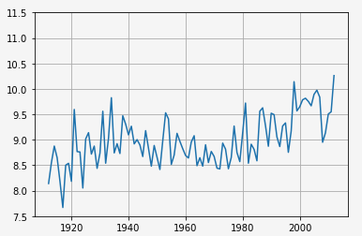
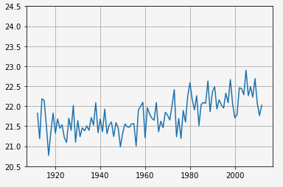
USA vs Australia
USA has a population of 330 million (increased from 92 million) and is situated in the northern hemisphere. Australia has a population of 25.5 million (increased from 4 million) and is in the southern hemisphere.
The rise in temperature for USA: The rise in temperature for Aus:
USA has had a population growth of 238 million and a change in temperature of 2 °C. Australia has had a population growth of 21.5 million and a temperature change of 0.5 °C.

Slide 7
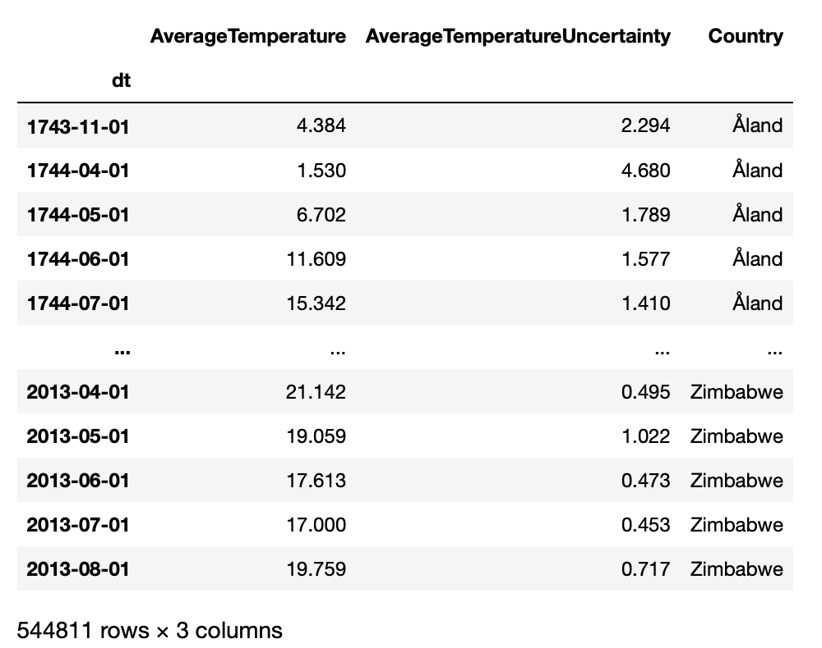

Exploration & Cleanup of Data
Global Land Temperatures By Country

Slide 8


Exploration & Cleanup of Data
Global Land Temperatures By Country
Population Total
Google APIs

Slide 9

Post Mortem
Dataset was limited
Historical (from early 1900’s) world population data was difficult to retrieve
Certain assumptions had to be made about the data

Slide 10
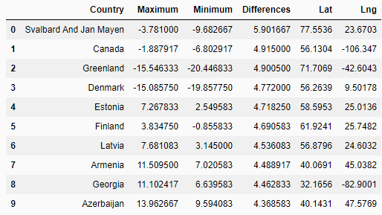
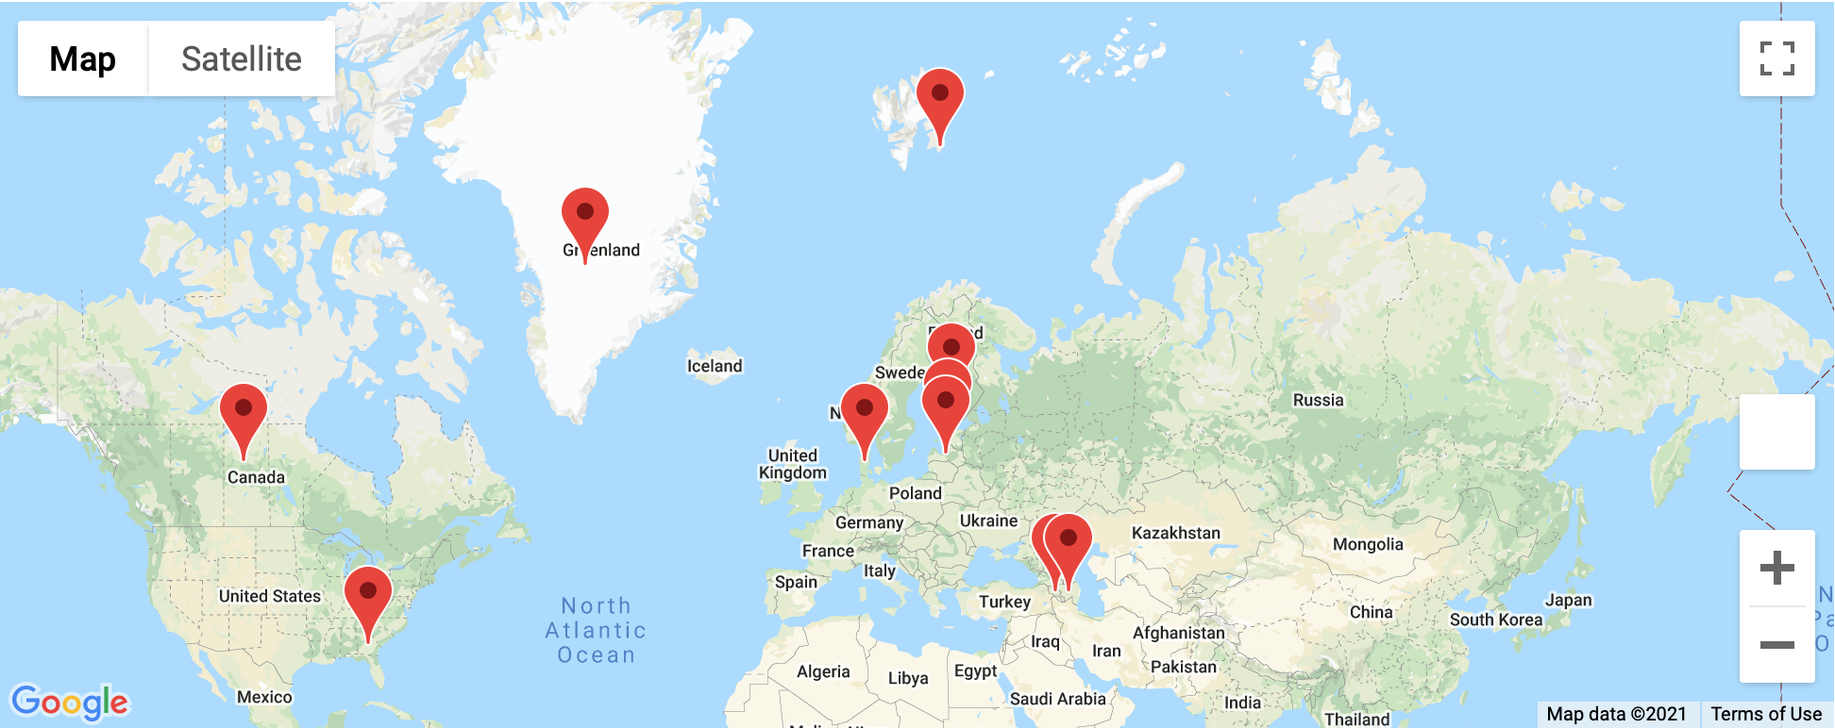
Difficulties
Trying to find the top ten countries affected by climate change
As dataset was limited we took maximum and minimum of changes to find differences
We also took the route of standard deviation and dividing the dataset into two halves
Countries displayed were close to Arctic Circle

Slide 11

Conclusion
We reject the null hypothesis in favour of the alternate hypothesis and can conclude that worldwide population growth has a direct correlation to changes in temperature
Temperature increase between Northern and Southern hemisphere differ and therefore we can conclude that population does affect the increase in temperature
More data is required to answer the specific questions about the countries most and least affected by climate change. Analysing major weather events around the globe would be the next step.

Slide 12


Any questions?

